Slide 1

Go, change the world
RV College of
Engineering
Unit 5
Transport Layer Security and Wireless Network Security

Slide 2

Go, change the world
RV College of
Engineering
Contents
Web Security Considerations.
Secure Socket Layer.
Transport Layer security.
HTTPS.
Wireless Network Security: Wireless Security, Mobile Device Security
IEEE 802.11 Wireless LAN overview.
IEEE 802.11i Wireless LAN Security – Services, Phases of operation.

Slide 3
Go, change the world
RV College of
Engineering
Web Security Considerations
Web now widely used by business, government, individuals but Internet & Web are vulnerable.
Have a variety of threats integrity confidentiality denial of service authentication
So need added security mechanisms

Slide 4
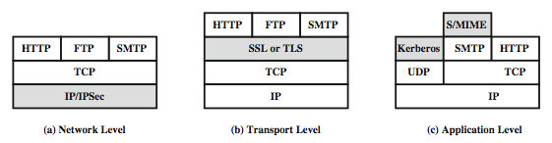
Go, change the world
RV College of
Engineering
Web Traffic Security Approaches

Slide 5
Go, change the world
RV College of
Engineering
SSL (Secure Socket Layer)
Transport layer security service originally developed by Netscape version 3 designed with public input
Subsequently became Internet standard known as TLS (Transport Layer Security)
Uses TCP to provide a reliable end-to-end service
SSL has two layers of protocols

Slide 6
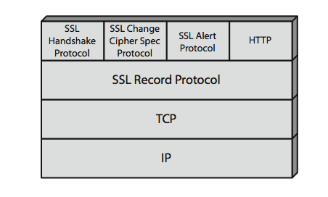
Go, change the world
RV College of
Engineering
SSL Architecture

Slide 7
Go, change the world
RV College of
Engineering
SSL Architecture
SSL connection
a transient, peer-to-peer, communications link
associated with 1 SSL session
SSL session
an association between client & server
created by the Handshake Protocol
define a set of cryptographic parameters
may be shared by multiple SSL connections

Slide 8
Go, change the world
RV College of
Engineering
SSL Record Protocol Services
confidentiality
using symmetric encryption with a shared secret key defined by Handshake Protocol
AES, IDEA, RC2-40, DES-40, DES, 3DES, Fortezza, RC4-40, RC4-128
message is compressed before encryption
message integrity
using a MAC with shared secret key
similar to HMAC but with different padding

Slide 9
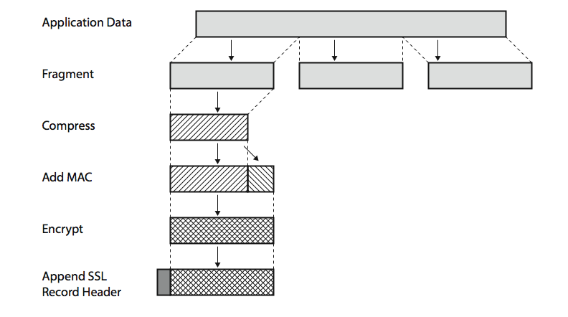
Go, change the world
RV College of
Engineering
SSL Record Protocol Operation

Slide 10
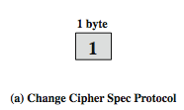
Go, change the world
RV College of
Engineering
SSL Change Cipher Spec Protocol
one of 3 SSL specific protocols which use the SSL Record protocol a single message causes pending state to become current hence updating the cipher suite in use

Slide 11

Go, change the world
RV College of
Engineering
SSL Alert Protocol
conveys SSL-related alerts to peer entity
severity
warning or fatal
specific alert
fatal: unexpected message, bad record mac, decompression failure, handshake failure, illegal parameter
warning: close notify, no certificate, bad certificate, unsupported certificate, certificate revoked, certificate expired, certificate unknown
compressed & encrypted like all SSL data

Slide 12

Go, change the world
RV College of
Engineering
SSL Handshake Protocol
allows server & client to:
authenticate each other
to negotiate encryption & MAC algorithms
to negotiate cryptographic keys to be used
comprises a series of messages in phases
Establish Security Capabilities
Server Authentication and Key Exchange
Client Authentication and Key Exchange
Finish

Slide 13
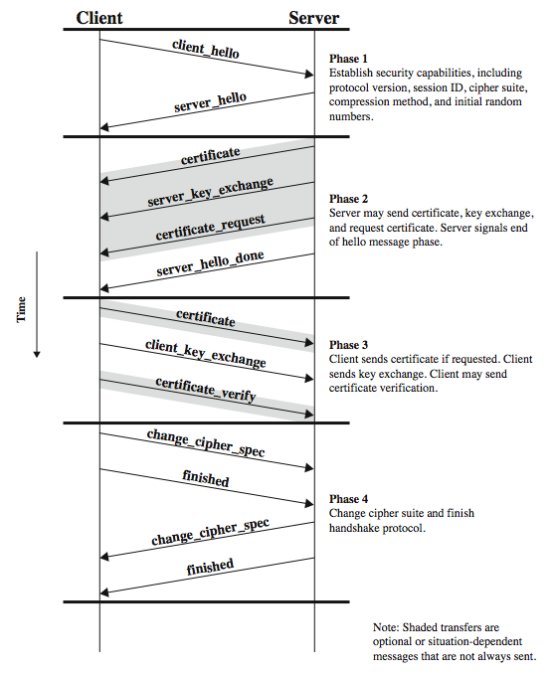
Go, change the world
RV College of
Engineering
SSL Handshake Protocol

Slide 14
Go, change the world
RV College of
Engineering
TLS (Transport Layer Security)
IETF standard RFC 2246 similar to SSLv3
with minor differences
in record format version number
uses HMAC for MAC
a pseudo-random function expands secrets
based on HMAC using SHA-1 or MD5
has additional alert codes
some changes in supported ciphers
changes in certificate types & negotiations
changes in crypto computations & padding

Slide 15
Go, change the world
RV College of
Engineering
HTTPS
HTTPS (HTTP over SSL)
combination of HTTP & SSL/TLS to secure communications between browser & server
documented in RFC2818
no fundamental change using either SSL or TLS
use https:// URL rather than http://
and port 443 rather than 80
encrypts
URL, document contents, form data, cookies, HTTP headers

Slide 16
Go, change the world
RV College of
Engineering
HTTPS Use
connection initiation
TLS handshake then HTTP request(s)
connection closure
have “Connection: close” in HTTP record
TLS level exchange close_notify alerts
can then close TCP connection
must handle TCP close before alert exchange sent or completed

Slide 17
Go, change the world
RV College of
Engineering
Wireless Security, Mobile Device Security
Key factors contributing to higher security risk of wireless networks compared to wired networks include:
Channel
Wireless networking typically involves broadcast communications, which is far more susceptible to eavesdropping and jamming than wired networks
Wireless networks are also more vulnerable to active attacks that exploit vulnerabilities in communications protocols
Mobility
Wireless devices are far more portable and mobile, thus resulting in a number of risks

Slide 18
Go, change the world
RV College of
Engineering
Resources
Some wireless devices, such as smartphones and tablets, have sophisticated operating systems but limited memory and processing resources with which to counter threats, including denial of service and malware
Accessibility
Some wireless devices, such as sensors and robots, may be left unattended in remote and/or hostile locations, thus greatly increasing their vulnerability to physical attacks

Slide 19
Go, change the world
RV College of
Engineering
802.11 Wireless LAN Security
Wired Equivalent Privacy (WEP) algorithm
802.11 privacy
Wi-Fi Protected Access (WPA)
Set of security mechanisms that eliminates most 802.11 security issues and was based on the current state of the 802.11i standard
Robust Security Network (RSN)
Final form of the 802.11i standard
Wi-Fi Alliance certifies vendors in compliance with the full 802.11i specification under the WPA2 program

Slide 20
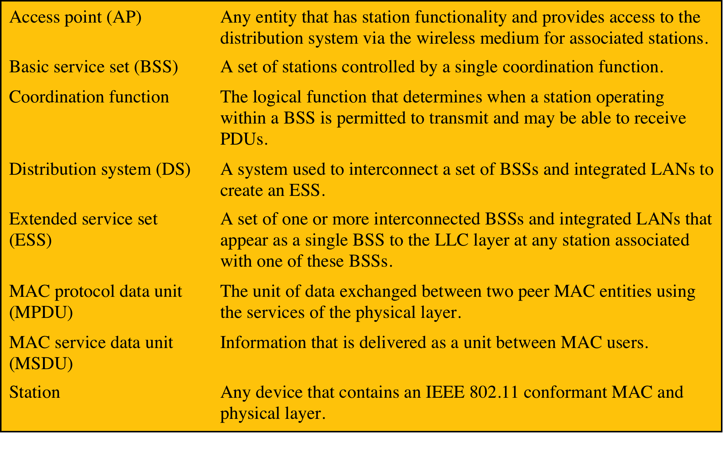

Go, change the world
RV College of
Engineering
IEEE 802.11 Terminology

Slide 21
Go, change the world
RV College of
Engineering
The Wi-Fi Alliance
802.11b
First 802.11 standard to gain broad industry acceptance
Wireless Ethernet Compatibility Alliance (WECA)
Industry consortium formed in 1999 to address the concern of products from different vendors successfully interoperating
Later renamed the Wi-Fi Alliance
Term used for certified 802.11b products is Wi-Fi
Has been extended to 802.11g products
Wi-Fi Protected Access (WPA)
Wi-Fi Alliance certification procedures for IEEE802.11 security standards
WPA2 incorporates all of the features of the IEEE802.11i WLAN security specification
Notes:
The first 802.11 standard to gain broad industry acceptance was 802.11b. Although
802.11b products are all based on the same standard, there is always a concern
whether products from different vendors will successfully interoperate. To meet
this concern, the Wireless Ethernet Compatibility Alliance (WECA), an industry
consortium, was formed in 1999. This organization, subsequently renamed the
Wi-Fi (Wireless Fidelity) Alliance, created a test suite to certify interoperability
for 802.11b products. The term used for certified 802.11b products is Wi-Fi . Wi-Fi
certification has been extended to 802.11g products. The Wi-Fi Alliance has also
developed a certification process for 802.11a products, called Wi-Fi5 . The Wi-Fi
Alliance is concerned with a range of market areas for WLANs, including enterprise,
home, and hot spots.
More recently, the Wi-Fi Alliance has developed certification procedures for
IEEE 802.11 security standards, referred to as Wi-Fi Protected Access (WPA). The
most recent version of WPA, known as WPA2, incorporates all of the features of
the IEEE 802.11i WLAN security specification.

Slide 22
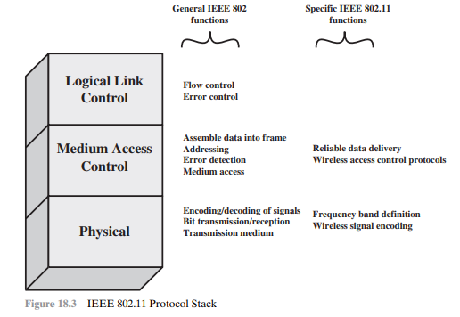
Go, change the world
RV College of
Engineering
IEEE 802 Protocol Architecture
Notes:
Before proceeding, we need to briefly preview the IEEE 802 protocol architecture.
IEEE 802.11 standards are defined within the structure of a layered set
of protocols. This structure, used for all IEEE 802 standards, is illustrated in
Figure 24.3 .
The lowest layer of the IEEE 802 reference model is the
physical layer , which includes such functions as encoding/decoding of signals and
bit transmission/reception. In addition, the physical layer includes a specification of
the transmission medium. In the case of IEEE 802.11, the physical layer also defines
frequency bands and antenna characteristics.
All LANs consist of collections of devices that share
the network’s transmission capacity. Some means of controlling access to the
transmission medium is needed to provide an orderly and efficient use of that
capacity. This is the function of a medium access control (MAC) layer. The MAC
layer receives data from a higher-layer protocol, typically the logical link control
(LLC) layer, in the form of a block of data known as the MAC service data unit
(MSDU). In general, the MAC layer performs the following functions:
• On transmission, assemble data into a frame, known as a MAC protocol data
unit (MPDU) with address and error-detection fields.
• On reception, disassemble frame, and perform address recognition and error
detection.
• Govern access to the LAN transmission medium.

Slide 23
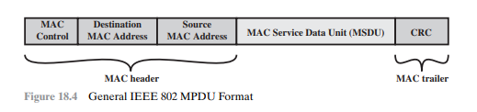
Go, change the world
RV College of
Engineering
Notes:
The exact format of the MPDU differs somewhat for the various MAC protocols
in use. In general, all of the MPDUs have a format similar to that of Figure 24.4 .
The fields of this frame are as follows:
• MAC Control: This field contains any protocol control information needed
for the functioning of the MAC protocol. For example, a priority level could
be indicated here.
• Destination MAC Address: The destination physical address on the LAN for
this MPDU.
• Source MAC Address: The source physical address on the LAN for this
MPDU.
• MAC Service Data Unit: The data from the next higher layer.
• CRC: The cyclic redundancy check field, also known as the Frame Check
Sequence (FCS) field. This is an error-detecting code, such as that which is
used in other data-link control protocols. The CRC is calculated based on the
bits in the entire MPDU. The sender calculates the CRC and adds it to the
frame. The receiver performs the same calculation on the incoming MPDU
and compares that calculation to the CRC field in that incoming MPDU. If the
two values don’t match, then one or more bits have been altered in transit.
The fields preceding the MSDU field are referred to as the MAC header, and
the field following the MSDU field is referred to as the MAC trailer. The header
and trailer contain control information that accompany the data field and that are
used by the MAC protocol.

Slide 24
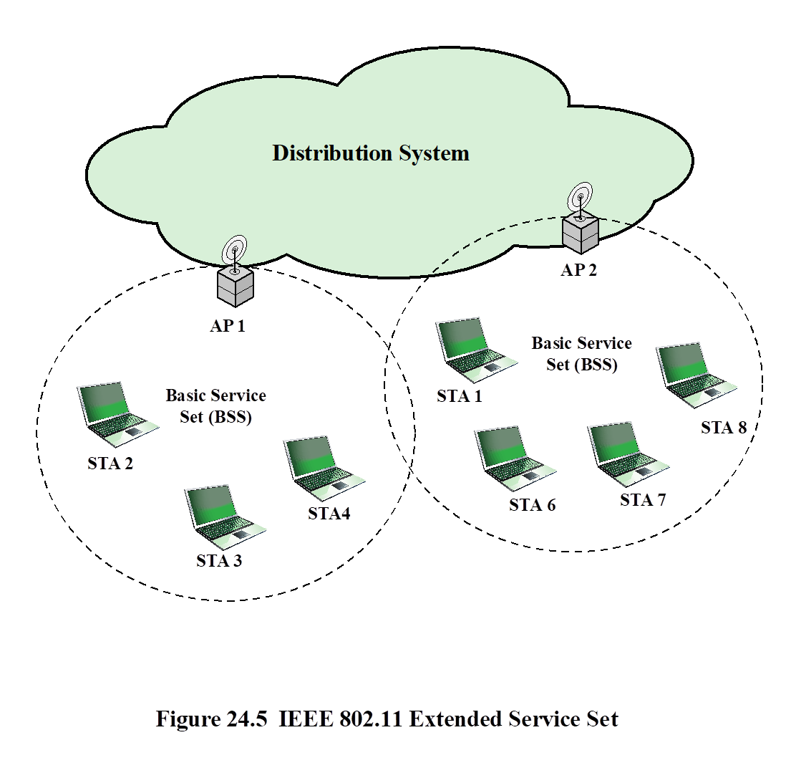
Go, change the world
RV College of
Engineering
IEEE 802.11 Network Components and Architectural Model
Notes:
the model developed by the 802.11 working group. The
smallest building block of a wireless LAN is a basic service set (BSS), which consists
of wireless stations executing the same MAC protocol and competing for access to
the same shared wireless medium. A BSS may be isolated or it may connect to a
backbone distribution system (DS) through an access point (AP). The AP functions
as a bridge and a relay point. In a BSS, client stations do not communicate directly
with one another. Rather, if one station in the BSS wants to communicate with
another station in the same BSS, the MAC frame is first sent from the originating
station to the AP and then from the AP to the destination station. Similarly, a MAC
frame from a station in the BSS to a remote station is sent from the local station to
the AP and then relayed by the AP over the DS on its way to the destination station.
The BSS generally corresponds to what is referred to as a cell in the literature. The
DS can be a switch, a wired network, or a wireless network.
When all the stations in the BSS are mobile stations that communicate directly
with one another (not using an AP) the BSS is called an independent BSS (IBSS).
An IBSS is typically an ad hoc network. In an IBSS, the stations all communicate
directly, and no AP is involved.
A simple configuration is shown in Figure 24.5 , in which each station belongs
to a single BSS; that is, each station is within wireless range only of other stations
within the same BSS. It is also possible for two BSSs to overlap geographically,
so that a single station could participate in more than one BSS. Furthermore, the
association between a station and a BSS is dynamic. Stations may turn off, come
within range, and go out of range.
An extended service set (ESS) consists of two or more basic service sets
interconnected by a distribution system. The extended service set appears as a
single logical LAN to the LLC level.

Slide 25
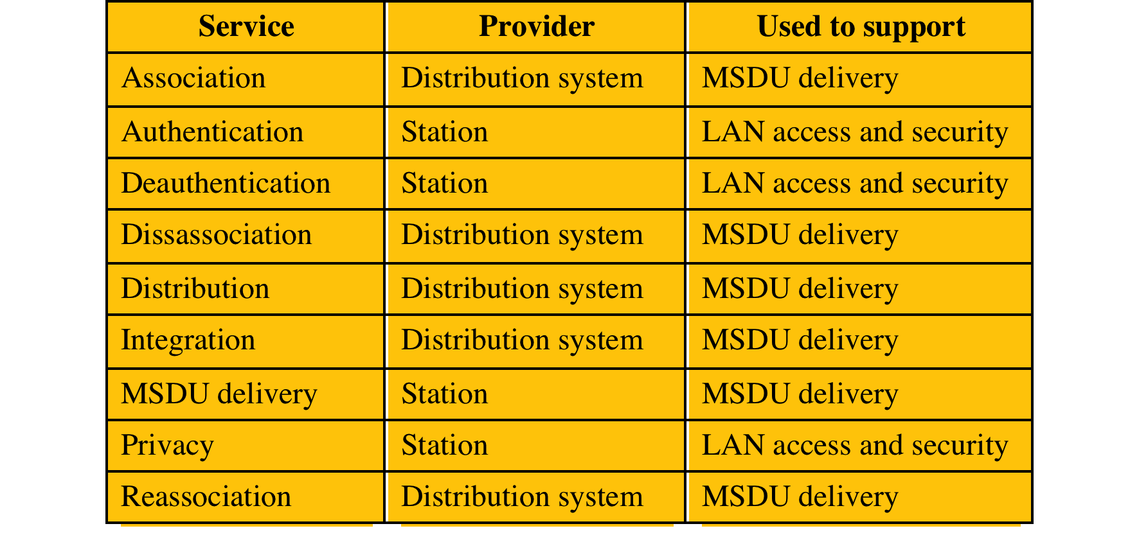
Go, change the world
RV College of
Engineering
IEEE 802.11 Services
Notes:
IEEE 802.11 defines nine services that need to be provided by the wireless LAN to
achieve functionality equivalent to that which is inherent to wired LANs. Table 24.2
lists the services and indicates two ways of categorizing them.
1. The service provider can be either the station or the DS. Station services
are implemented in every 802.11 station, including AP stations. Distribution
services are provided between BSSs; these services may be implemented in an
AP or in another special-purpose device attached to the distribution system.
2. Three of the services are used to control IEEE 802.11 LAN access and
confidentiality. Six of the services are used to support delivery of MSDUs
between stations. If the MSDU is too large to be transmitted in a single
MPDU, it may be fragmented and transmitted in a series of MPDUs.
Following the IEEE 802.11 document, we next discuss the services in an order
designed to clarify the operation of an IEEE 802.11 ESS network. MSDU delivery ,
which is the basic service, has already been mentioned.

Slide 26
Go, change the world
RV College of
Engineering
Distribution of Messages Within a DS
The two services involved with the distribution of messages within a DS are:
Distribution
Integration
Distribution
The primary service used by stations to exchange MPDUs when the MPDUs must traverse the DS to get from a station in one BSS to a station in another BSS
Integration
Enables transfer of data between a station on an IEEE 802.11 LAN and a station on an integrated IEEE 802x LAN
Service enables transfer of data between a station on an IEEE 802.11 LAN and a station on an integrated IEEE 802.x LAN
Notes:
The two services involved with the
distribution of messages within a DS are distribution and integration. Distribution
is the primary service used by stations to exchange MPDUs when the MPDUs must
traverse the DS to get from a station in one BSS to a station in another BSS. For
example, suppose a frame is to be sent from station 2 (STA 2) to station 7 (STA 7)
in Figure 24.5 . The frame is sent from STA 2 to AP 1, which is the AP for this BSS.
The AP gives the frame to the DS, which has the job of directing the frame to the
AP associated with STA 7 in the target BSS. AP 2 receives the frame and forwards
it to STA 7. How the message is transported through the DS is beyond the scope of
the IEEE 802.11 standard.
If the two stations that are communicating are within the same BSS, then the
distribution service logically goes through the single AP of that BSS.
The integration service enables transfer of data between a station on an IEEE
802.11 LAN and a station on an integrated IEEE 802.x LAN. The term integrated
refers to a wired LAN that is physically connected to the DS and whose stations
may be logically connected to an IEEE 802.11 LAN via the integration service. The
integration service takes care of any address translation and media conversion logic
required for the exchange of data.

Slide 27
Go, change the world
RV College of
Engineering
Association-Related Services
Transition types, based on mobility:
No transition
A station of this type is either stationary or moves only within the direct communication range of the communicating stations of a single BSS
BSS transition
Station movement from one BSS to another BSS within the same ESS; delivery of data to the station requires that the addressing capability be able to recognize the new location of the station
ESS transition
Station movement from a BSS in one ESS to a BSS within another ESS; maintenance of upper-layer connections supported by 802.11 cannot be guaranteed
Notes:
The primary purpose of the MAC layer is to
transfer MSDUs between MAC entities; this purpose is fulfilled by the distribution
service. For that service to function, it requires information about stations within
the ESS that is provided by the association-related services. Before the distribution
service can deliver data to or accept data from a station, that station must be
associated . Before looking at the concept of association, we need to describe the
concept of mobility. The standard defines three transition types, based on mobility:
• No transition: A station of this type is either stationary or moves only within
the direct communication range of the communicating stations of a single BSS.
• BSS transition: This is defined as a station movement from one BSS to
another BSS within the same ESS. In this case, delivery of data to the station
requires that the addressing capability be able to recognize the new location
of the station.
• ESS transition: This is defined as a station movement from a BSS in one ESS
to a BSS within another ESS. This case is supported only in the sense that
the station can move. Maintenance of upper-layer connections supported
by 802.11 cannot be guaranteed. In fact, disruption of service is likely to
occur.

Slide 28
Go, change the world
RV College of
Engineering
Services
Association
Establishes an initial association between a station and an AP
Reassociation
Enables an established association to be transferred from one AP to another, allowing a mobile station to move from one BSS to another
Disassociation
A notification from either a station or an AP that an existing association is terminated

Slide 29
Go, change the world
RV College of
Engineering
Wireless LAN Security
Wired Equivalent Privacy (WEP) algorithm
802.11 privacy
Wi-Fi Protected Access (WPA)
Set of security mechanisms that eliminates most 802.11 security issues and was based on the current state of the 802.11i standard
Robust Security Network (RSN)
Final form of the 802.11i standard
Wi-Fi Alliance certifies vendors in compliance with the full 802.11i specification under the WPA2 program

Slide 30
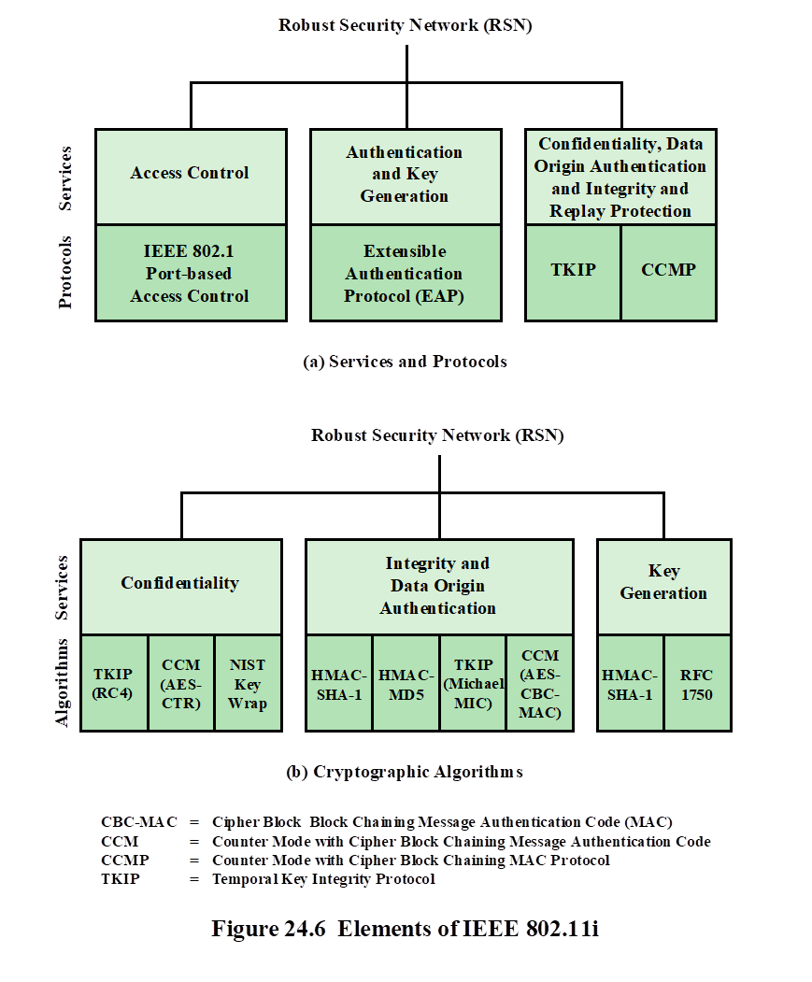
Go, change the world
RV College of
Engineering
Elements of IEEE 802.11i
Notes:
The 802.11i RSN security specification defines the following services.
• Authentication: A protocol is used to define an exchange between a user and an
AS (authentication server) that provides mutual authentication and generates
temporary keys to be used between the client and the AP over the wireless link.
• Access control: This function enforces the use of the authentication function,
routes the messages properly, and facilitates key exchange. It can work with a
variety of authentication protocols.
• Privacy with message integrity: MAC-level data (e.g., an LLC PDU) are
encrypted along with a message integrity code that ensures that the data have
not been altered.

Slide 31
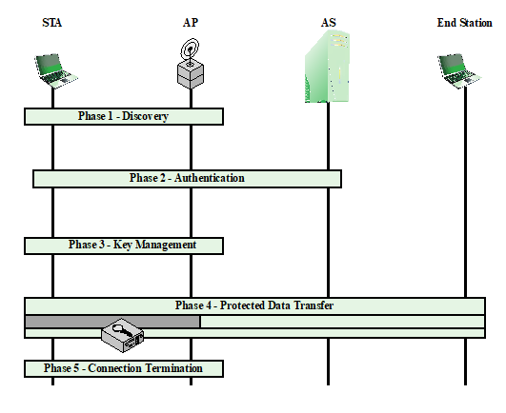
Go, change the world
RV College of
Engineering
Phases of operation
Notes:
The operation of an IEEE 802.11i RSN can be broken down into five distinct
phases. The exact nature of the phases will depend on the configuration and the end
points of the communication. Possibilities include (see Figure 24.5 ):
1. Two wireless stations in the same BSS communicating via the access point for
that BSS.
2. Two wireless stations (STAs) in the same ad hoc IBSS communicating directly
with each other.
3. Two wireless stations in different BSSs communicating via their respective
APs across a distribution system.
4. A wireless station communicating with an end station on a wired network via
its AP and the distribution system.
IEEE 802.11i security is concerned only with secure communication between
the STA and its AP. In case 1 in the preceding list, secure communication is assured
if each STA establishes secure communications with the AP. Case 2 is similar,
with the AP functionality residing in the STA. For case 3, security is not provided
across the distribution system at the level of IEEE 802.11, but only within each BSS.
End-to-end security (if required) must be provided at a higher layer. Similarly, in
case 4, security is only provided between the STA and its AP.
With these considerations in mind, Figure 24.7 depicts the five phases of
operation for an RSN and maps them to the network components involved. One
new component is the authentication server (AS). The rectangles indicate the
exchange of sequences of MPDUs. The five phases are defined as follows:
• Discovery: An AP uses messages called Beacons and Probe Responses to
advertise its IEEE 802.11i security policy. The STA uses these to identify an
AP for a WLAN with which it wishes to communicate. The STA associates
with the AP, which it uses to select the cipher suite and authentication
mechanism when the Beacons and Probe Responses present a choice.
• Authentication: During this phase, the STA and AS prove their identities to each
other. The AP blocks non-authentication traffic between the STA and AS until
the authentication transaction is successful. The AP does not participate in the
authentication transaction other than forwarding traffic between the STA and AS.
Key Management: The AP and the STA perform several operations
that cause cryptographic keys to be generated and placed on the AP and
the STA. Frames are exchanged between the AP and STA only.
• Protected data transfer: Frames are exchanged between the STA and the end
station through the AP. As denoted by the shading and the encryption module
icon, secure data transfer occurs between the STA and the AP only; security is
not provided end-to-end.
• Connection termination: The AP and STA exchange frames. During this
phase, the secure connection is torn down and the connection is restored to
the original state.

Slide 32
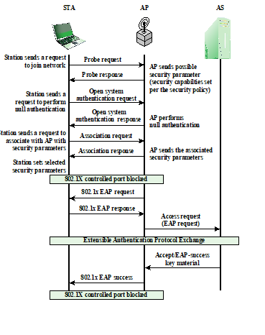
Go, change the world
RV College of
Engineering
IEEE 802.11i Phases of Operation: Capability Discovery, Authentication, and Association

